Slide 1
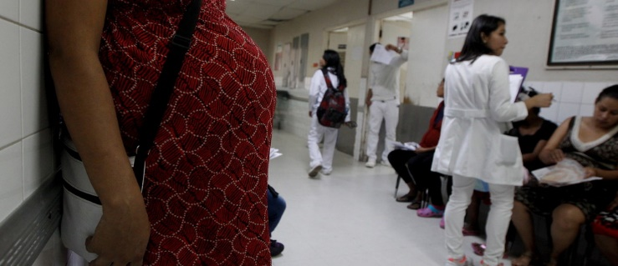
Modeling Maternal Mortality Rates (MMR): How are we Failing Mothers?
Rebecca Minich
10.27.16
Notes:
https://assets.weforum.org/article/image/large_b05pCeiWDULOlBGVxJ52gFYvy6EPYx8R5WyOhPz1lNQ.jpg

Slide 2
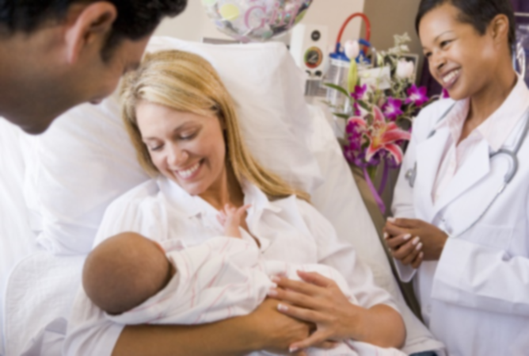
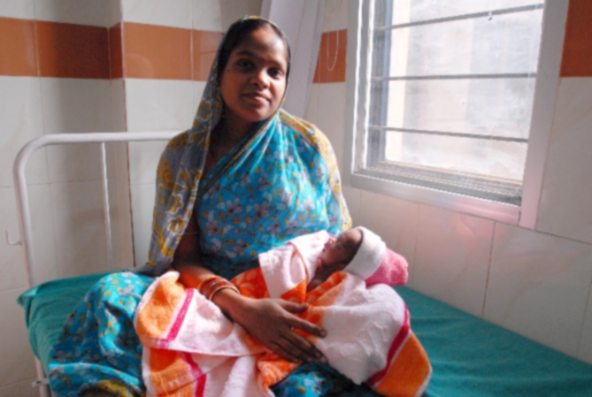
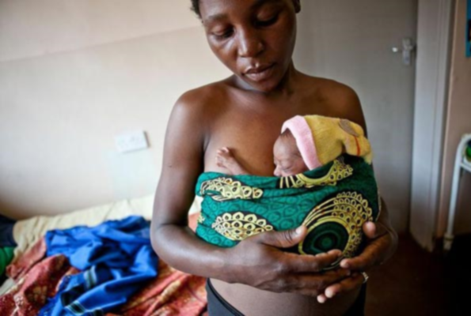
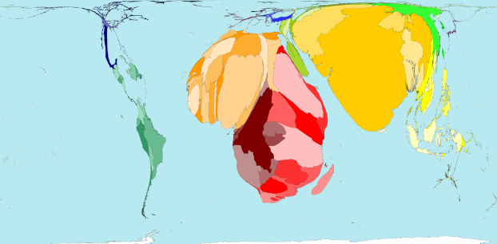
The Problem
Finland: 3
India: 174
Sierra Leone: 1360
Notes:
Median MMR was 54 deaths per 100k live births.
Min: Finland w/ 3
Max: Sierra Leone w/ 1360
CURRENT: MMR of 216 per 100k
GOAL: Global MMR of 70 per 100k by 2030
Western mom - https://www.oakbendmedcenter.org/wp-content/uploads/2015/04/bigstock-New-Parents-With-Baby-Talking-4637025.jpg
Western mom - http://www.affordabledaycare.net/stk25210nwl.jpg
Orissa mom - https://upload.wikimedia.org/wikipedia/commons/c/c7/Mother_and_newborn_child_in_Orissa.jpg
East Africa mom - http://healthreportereastafrica.com/wp-content/uploads/2016/01/premature-babies-ug.jpg
Worldmapper - http://www.worldmapper.org/display.php?selected=258

Slide 3
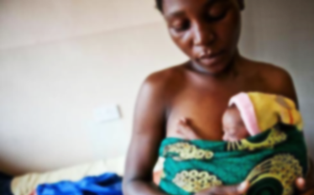
What factors contribute to global MMR?
Interventions focus on providing:
Access to prenatal care
Labor/delivery education
Births attended by skilled professionals
Emergency care for complications
Notes:
Numerous sociopolitical factors contribute, you can see this at play with the individual states in the US. In regions with high MMRs,

Slide 4
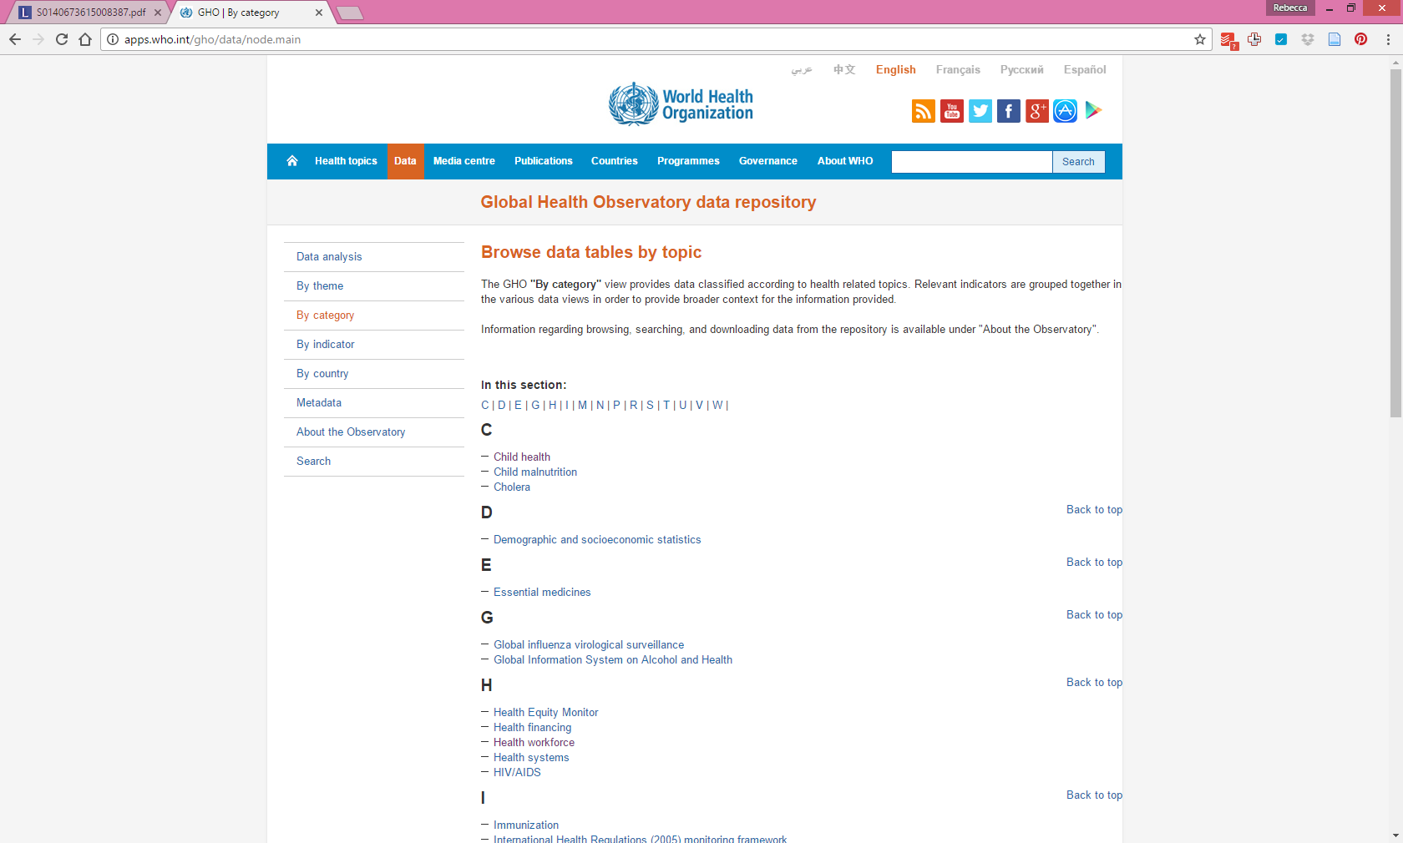
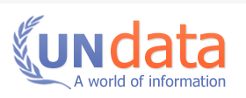


Could other factors contribute to MMR?
Data gathered so far
Human development index: (life expectancy, education, GDP-PPP, etc)
MMR
Abortion restrictions scale
Birth attended by skilled professional
Prenatal care
Adolescent birth rates
Child death and survival
Access to, and cost of prescription medications
Notes:
Main data sources for HDI data - Column 1: HDRO calculations based on data from UNDESA (2015), UNESCO Institute for Statistics (2015), United Nations Statistics Division (2015), World Bank (2015a), Barro and Lee (2014) and IMF (2015). Column 2: UNDESA (2015). Column 3: UNESCO Institute for Statistics (2015). Column 4: UNESCO Institute for Statistics (2015), Barro and Lee (2014), UNICEF Multiple Indicator Cluster Surveys and ICF Macro Demographic and Health Surveys. Column 5: World Bank (2015a), IMF (2015) and United Nations Statistics Division (2015). Column 6: Calculated based on data in columns 1 and 5.

Slide 5
Which areas of the data have you cleaned, and which areas still need cleaning?
API Work
CSV
WHO: Uses XML,
attempting to convert to json by un-nesting with Python and Pandas
UN: Uses SOAP
Haven’t even tried it yet
CFRR: PDF factsheets Put data into CSV by hand
CFRR: Created a scale from 0-6 for access to safe abortions by UN country
WHO and UN: created Pandas.df that includes HDI and MMR info.
Cleaning: Indexed on Countries, found redundant country values and flattened, IDed missing values in pd.df
Notes:
Although the social burdens alone make this an important public health issue, there is also a steep economic cost HL in the form of disability, loss of days worked and the cost of devices to improve hearing. To better understand the progression of AHL I am going to describe mammalian auditory transduction

Slide 6
What steps have you taken to explore the data?
CFRR: Created a scale from 0-6 for access to safe abortions by UN country
WHO and UN: created Pandas.df that includes HDI and MMR info.
Cleaning: Indexed on Countries, found redundant country values and flattened, IDed missing values in pd.df
Notes:
Although the social burdens alone make this an important public health issue, there is also a steep economic cost HL in the form of disability, loss of days worked and the cost of devices to improve hearing. To better understand the progression of AHL I am going to describe mammalian auditory transduction

Slide 7
What insights have you gained from your exploration?
CFRR: Created a scale from 0-6 for access to safe abortions by UN country
WHO and UN: created Pandas.df that includes HDI and MMR info.
Cleaning: Indexed on Countries, found redundant country values and flattened, IDed missing values in pd.df
Notes:
Although the social burdens alone make this an important public health issue, there is also a steep economic cost HL in the form of disability, loss of days worked and the cost of devices to improve hearing. To better understand the progression of AHL I am going to describe mammalian auditory transduction

Slide 8
Future Goals
Will you be able to answer your question with this data?
The hypothesis aims to determine socioeconomic factors that are targets for intervention. With the current data, a model will be able to exhibit correlations of column features to MMR but cannot show a causal links.
How might you use modeling to answer your question?
It is necessary to explore several methods to determine the most appropriate model. Logistic regression or random forest could be used. For logistic regression, the response variable (MMR) would have to be grouped (ex: above or below global median?).
Notes:
Although the social burdens alone make this an important public health issue, there is also a steep economic cost HL in the form of disability, loss of days worked and the cost of devices to improve hearing. To better understand the progression of AHL I am going to describe mammalian auditory transduction

Slide 9
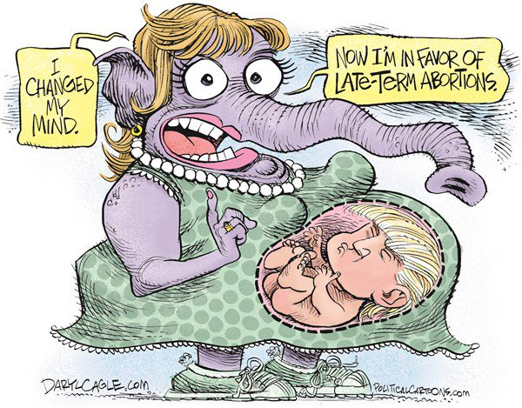
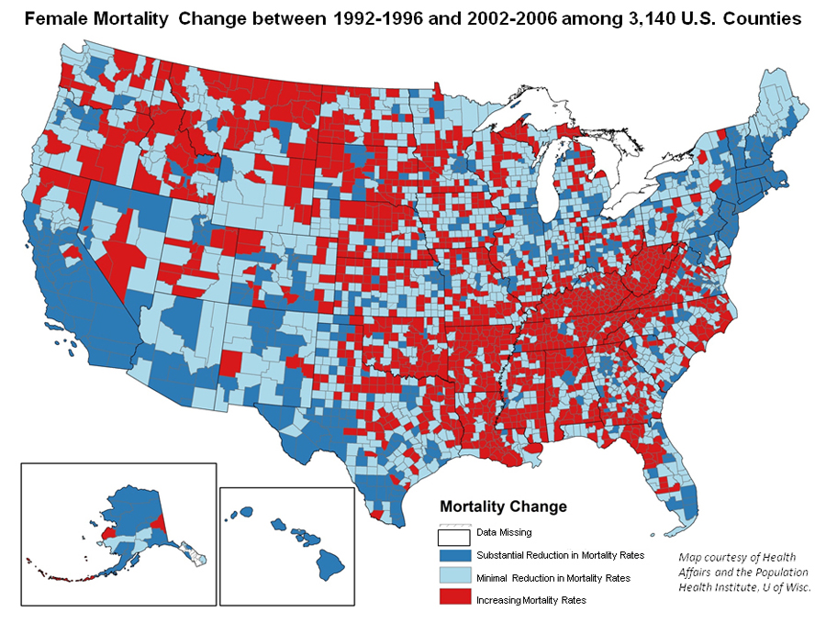
Pet Project
“I bet the Republican Party wishes there was a way to have a late-term abortion for their presidential nominee”
Notes:
Although the social burdens alone make this an important public health issue, there is also a steep economic cost HL in the form of disability, loss of days worked and the cost of devices to improve hearing. To better understand the progression of AHL I am going to describe mammalian auditory transduction

